Slide 1
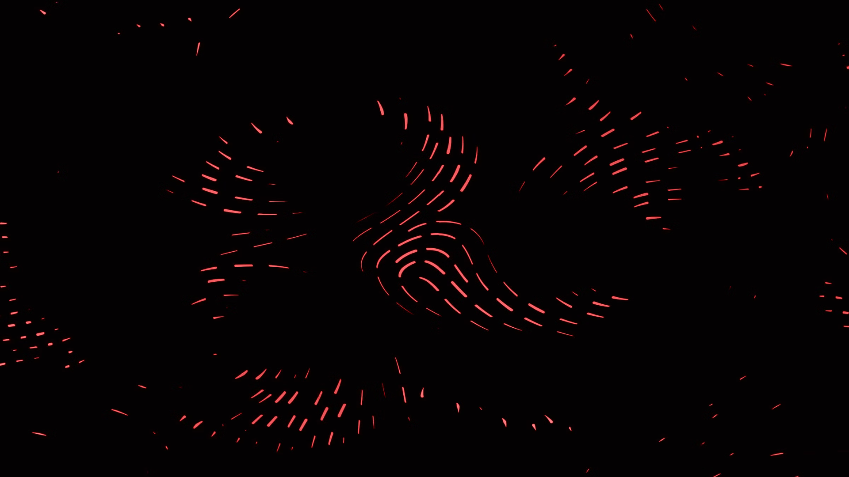
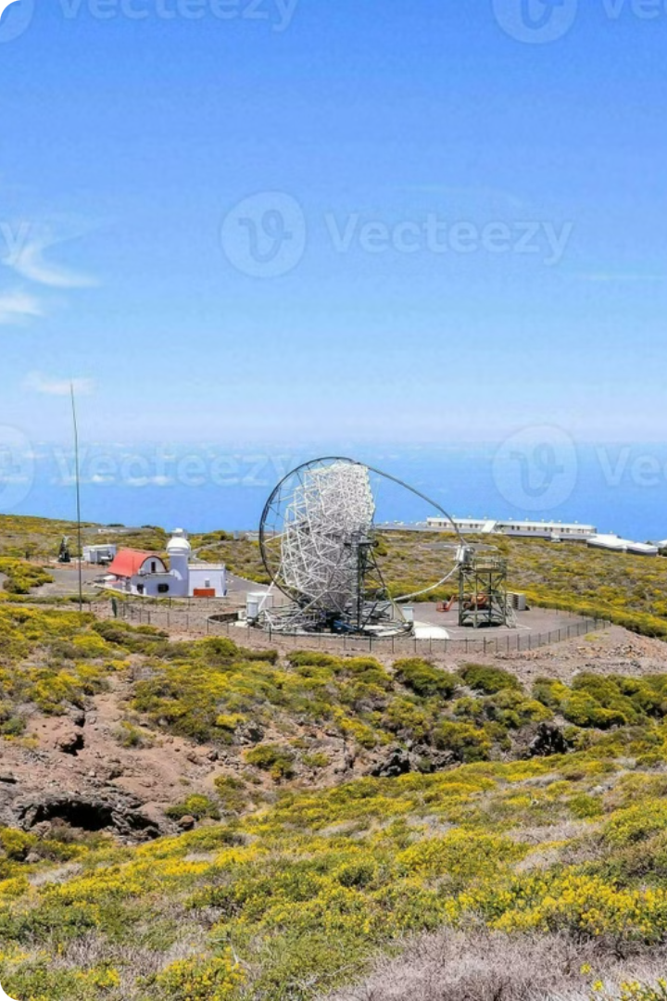

Astro-Alliance (StarLab): Radio Telescope Project

Slide 2
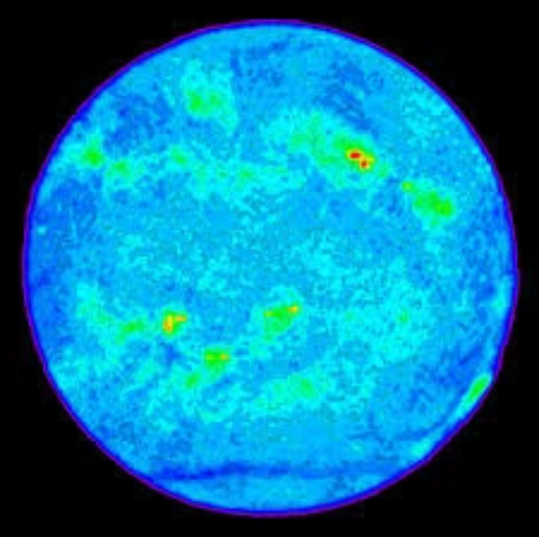
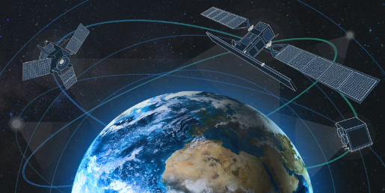
Project Objectives
1
Mapping the Night Sky
2
To receive and process radio signals from the Sun
Tracing the path of man made satellites in the night sky.

Slide 3

Planning and Resources
We will be using the Stellarium Web Sky Chart software to identify celestial objects and plan our observations.
Once you enter your accurate location, the software can tell you the current and future position of every night sky object.
This will help us plan or our telescope orientation and observations.

Slide 4
Stand Design
The Stand will be made of Aluminum.
The stand will consist of a rectangular base with a hole in the center for the mounting pole. For supporting the mount, a block with a hole in the center will be attached to it with four supporting legs.
The pole is required to spin, thus two small hollow cylinders will be put in the base and support holes to lubricate the rotation of the pole. Further lubricating oil will be added for more lubrication.
A nail with a curved head will be fitted at the bottom of the pole to make the rotation easier.
All the joints are made with the help of hot glue and screws.

Slide 5
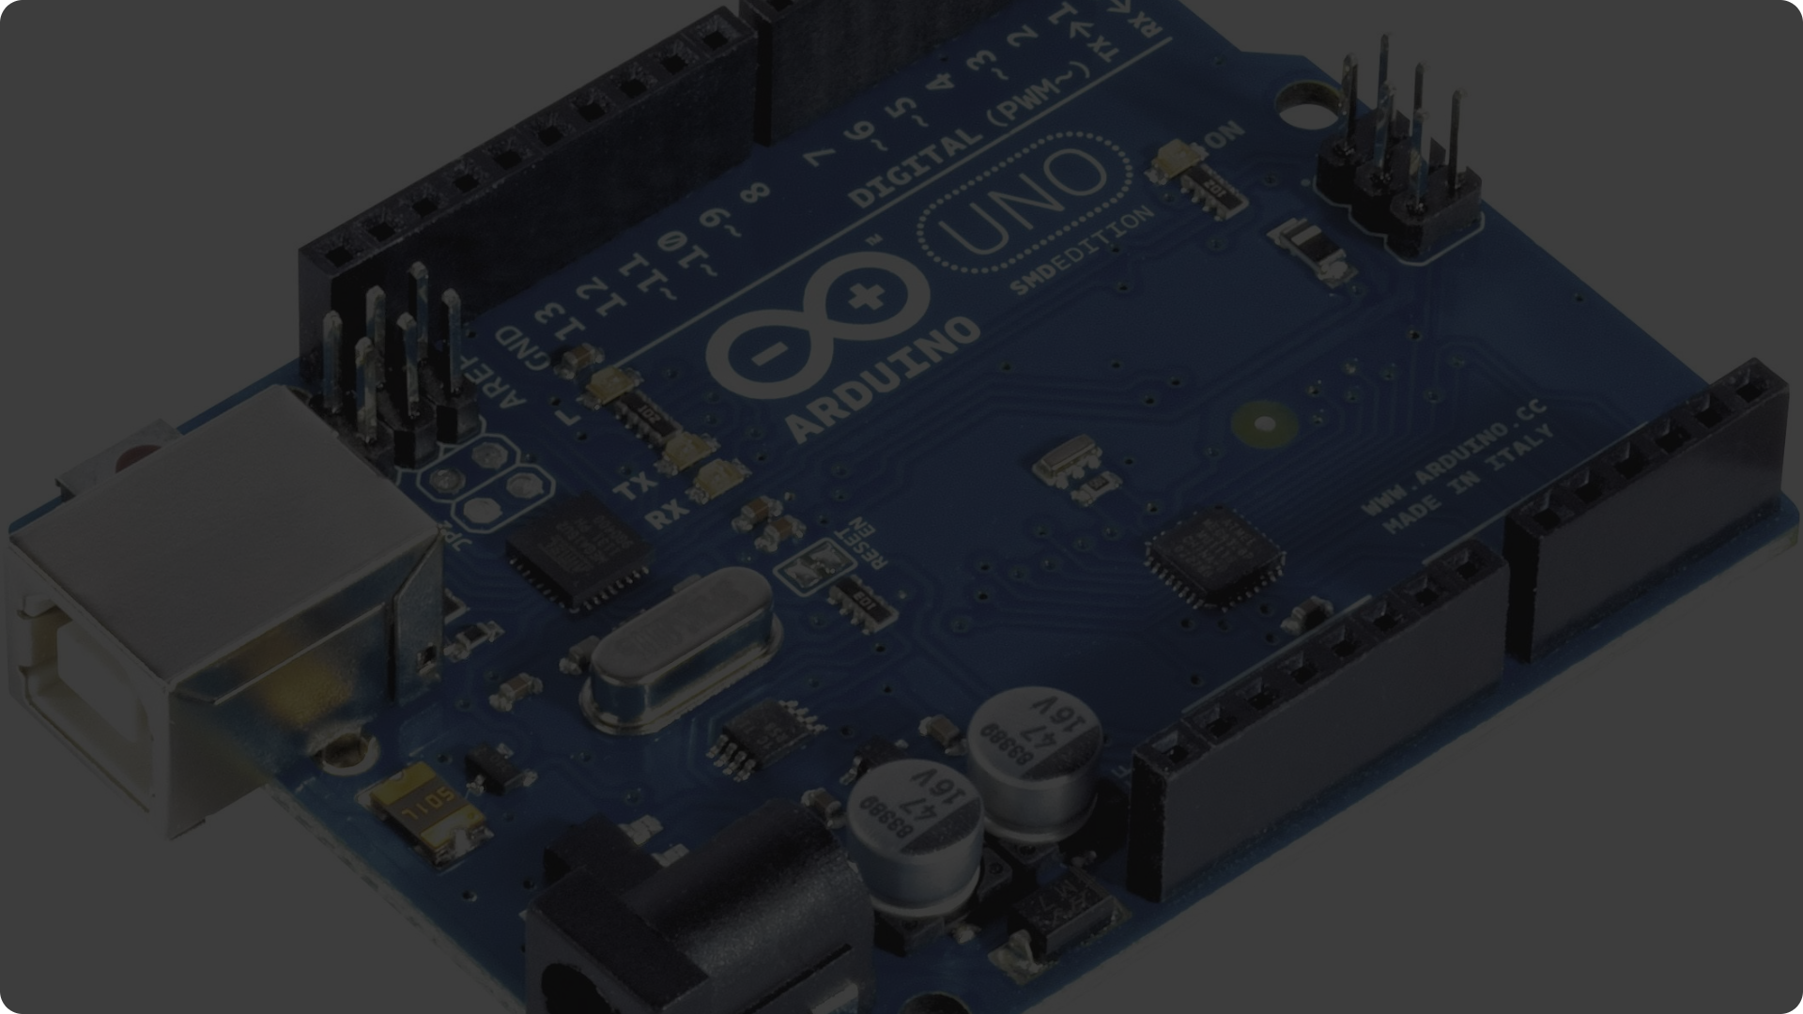


Telescope Control System - Microcontroller and Joystick Control
Arduino Microcontroller
Joystick Control
The telescope's movement will be automated using an Arduino microcontroller, which will be interfaced with a computer to provide full control over the stepper motor's operation.
A joystick or gamepad will be connected to the microcontroller. The microcontroller will be programmed to translate joystick movements into corresponding motor control signals. This will allow the telescope's movement direction and speed to be manually controlled.

Slide 6
Motor Selection
1
Our ALtAz setup will utilize two distinct motors - one to control Azimuth and the other to manage Altitude.
2
The parabolic reflector dish we will be using will be of 14 kg. Calculating the torque required for the both the motors, The Azimuth motor is taken of 6.5 kg cm and the Altitude motor is to be taken of 18.9 kg cm.
3
These motors will be attached with a pair of gears each of appropriate gear ratio, so that it can support the dish despite its low torque rating.
4
Double helical gears will be printed using a 3D printer to reduce slippage.

Slide 7
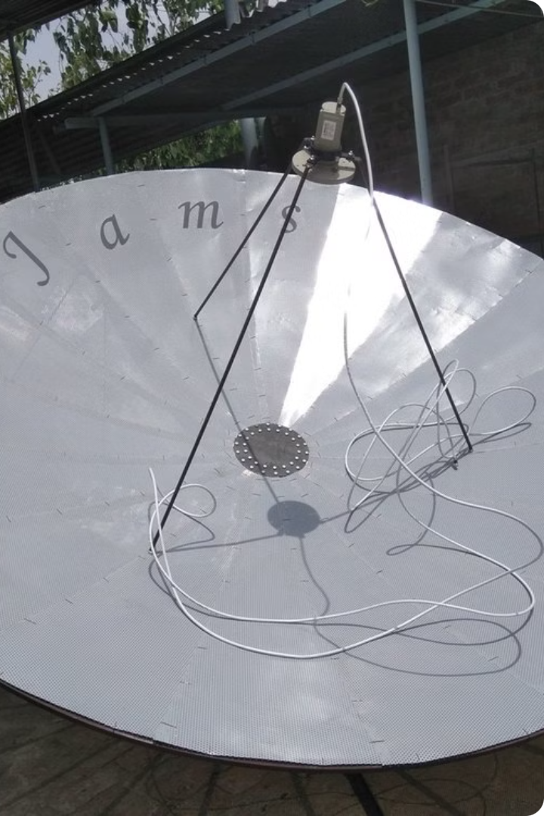
Parabolic Dish
We will be using a 6 ft wide parabolic dish made up of aluminum mesh with a focal length of 29.72 cm.
The dish concentrate all the EM waves on its focal point, where an LNB will be put in place to collect the reflected waves.
Resolution = Wavelength / Diameter = 12.87 - 15.33

Slide 8
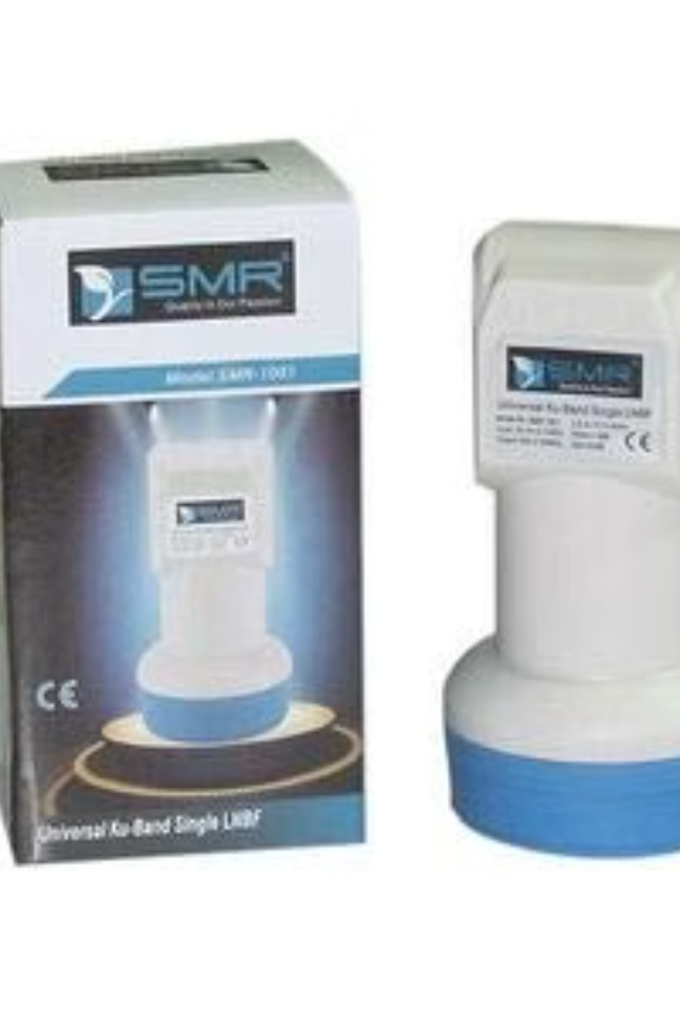
Low Noise Blocker
An LNB collects EM waves and amplifies the waves of certain bandwidth and converts them to a lower frequency, suitable for Electronic parts.
We will be using a Ku Band LNB (10.7 to 12.75 GHz)
It will be mounted on the arm of the antenna.

Slide 9
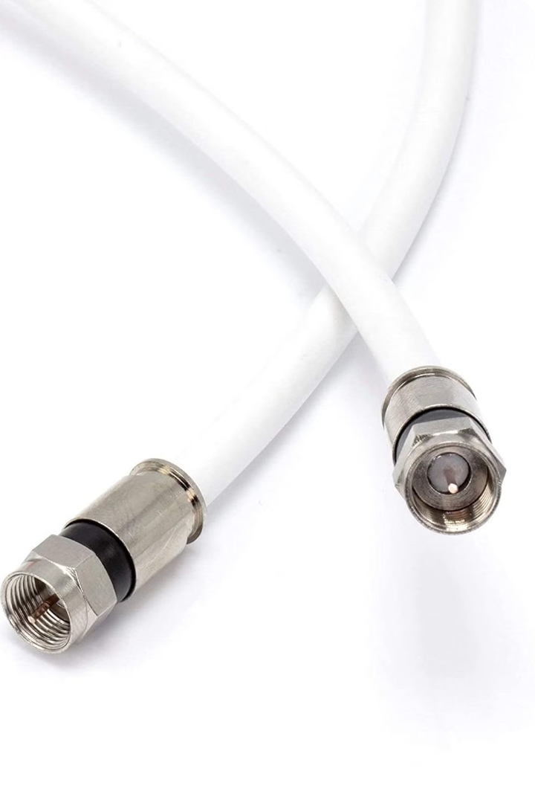
Coaxial Cable
Consists of two separate layers.
Central Copper layer transmits electrical signals.
Outer layer mesh shields against electromagnetic interference.
Makes it suitable for Radio transmission.

Slide 10
Interfacing with PC (Without SDR)
Output voltage of the satellite finder ∝ Strength of the signal received.
This input voltage can be fed in the Arduino.
Voltage level to the respective coordinates will be assigned and stored.
This is will give us the satellite coordinates.
These values will be used to calculate the intensity of the pixel.
In this manner we will capture an image with varying pixel intensity where high intensity shows the presence of satellite and low intensity noise.

Slide 11
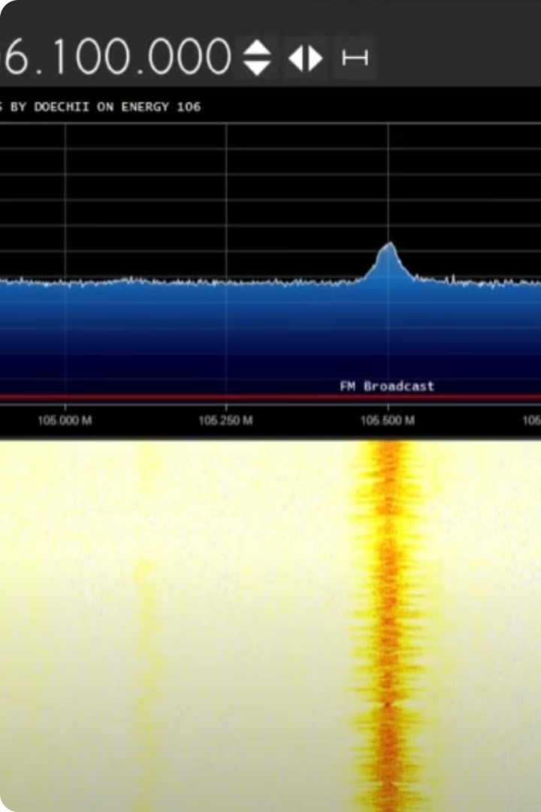
Interfacing with PC
The Arduino Microcontroller will be connected to our PC through USB.
A SDR (Software Defined Radio) software will be used for recording and collection of data.
A SDR (Software Defined Radio) software will be used for recording and collection of data.

